Slide 1


Cab Ride Fare Prediction
Group – 17
Monil Rawka (rawka.m@northeastern.edu)
Amrutha Bharati (bharati.am@northeastern.edu

Slide 2
Contents
1. Problem Setting
2. Problem Definition
3. Data Collection
4. Data Processing
5. Data Exploration
6. Model Exploration and Selection
7. Result and Conclusion

Slide 3

Problem Setting
The use of data to forecast future trends and events is known as predictive analytics. Analysts can use predictive analytics to foresee if a change will help them reduce risks, improve operations, and/or increase revenue. JMD cab company plans to launch their services across Boston, Massachusetts. Based on the data collected over the years, JMD wants to develop an algorithm to forecast ride fares.

Slide 4

Problem Definition
Price prediction is a statistical technique for estimating the relationship between a target variable (here, cab fare) and one or more independent or interdependent factors, or predictors, that influence the target variable. Regression analysis also lets researchers determine how much these predictors influence a target variable. In order to estimate the approximate cab fare, we would like to develop an algorithm that can consider many different attributes like passenger count, distance, ride duration, time, and vehicle type.

Slide 5
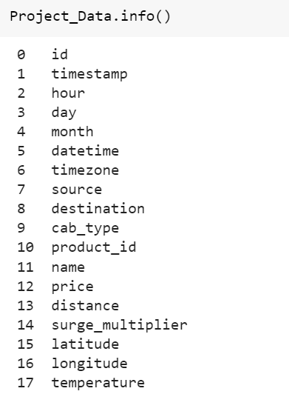
Data Collection
The original data is obtained from Kaggle. It CSV file namely RideShare_data.csv, This dataset contains 307408 unique rows and 28 columns.
Data Source link: https://www.kaggle.com/code/hjaimes/uber-and-lyft-data-boston-ma-machine-learning/data
Dataset describes cab ride details like source, destination, distance, price, car type, and weather conditions like temperature, wind speed, and visibility. This dataset has been generated over a period based on which price prediction is to be done. This data also contains a dataset that has data pertaining to multiple cab service providers.

Slide 6
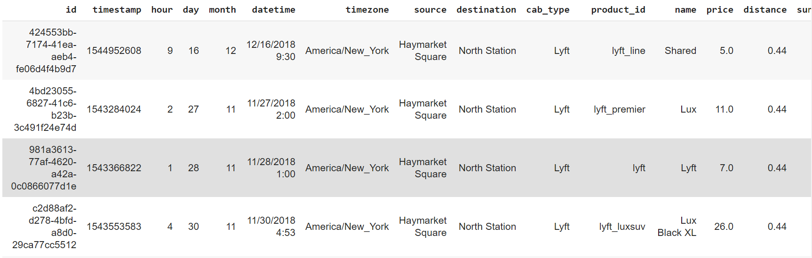
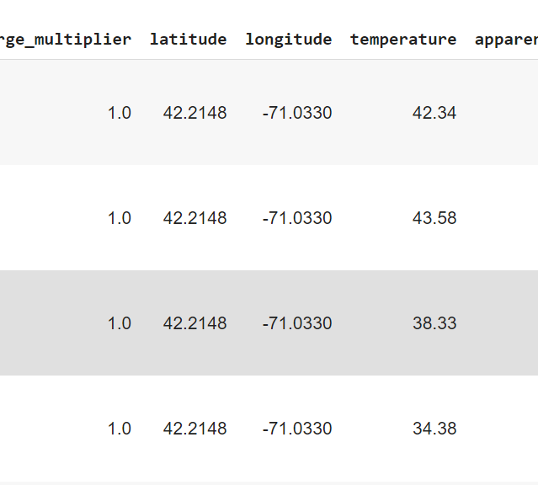
Data Processing
To clean the data, we first removed all special characters like $, @, >, <, etc. The null values were replaced with the mean, median, or mode of the respective columns.
All the timestamps to the 12-hour clock with AM or PM for convenience.
Time 24-hr clock to 12-hr clock.
All duplicate records were removed the data was normalized.

Slide 7
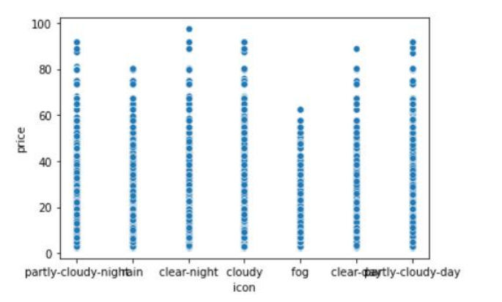
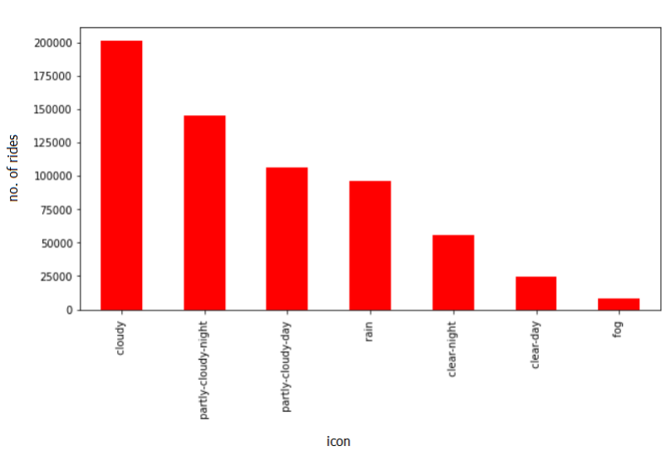
Data Exploration
Price v/s icon
No. of Rides v/s Icon

Slide 8
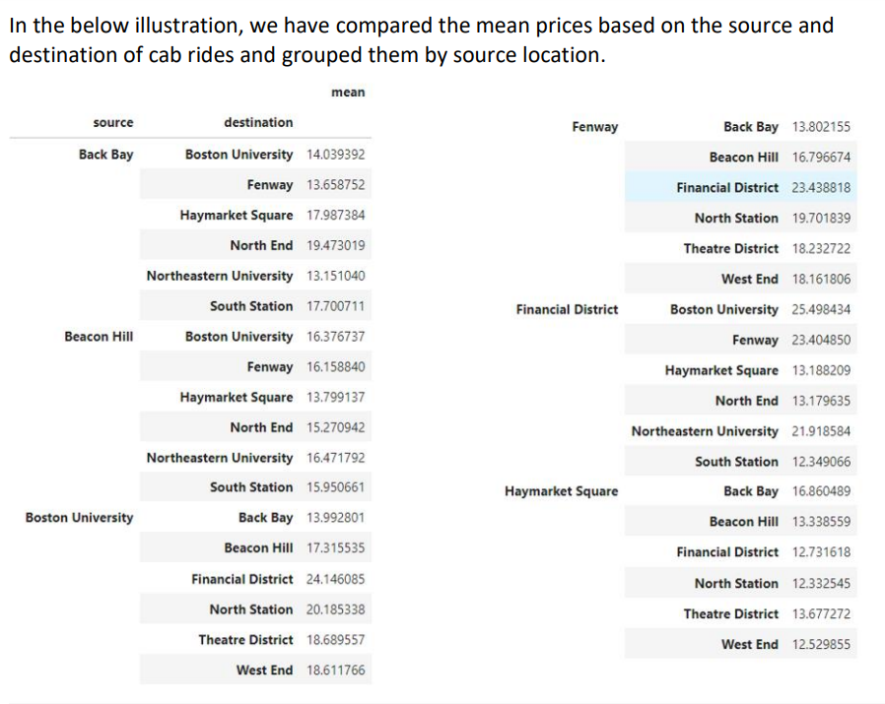
Data
Exploration

Slide 9
Model Exploration and Selection
In the process of selecting a model for prediction, we implemented 3 different models on our Dataset to estimate the accuracy. The dataset was then split into train and validation sets with a split of 70% and 30% respectively.
1. Linear regression
2. LASSO linear regression
3. Decision Tree
4. XG Boost Algorithm
5. K-NN

Slide 10
Linear Regression
Regression models are target prediction values based on independent variables. It is mostly used for finding out the relationship between variables and forecasting. The results were obtained as:
R Square: 0.929319915943267
Mean Square Error: 5.3343793736883525
Root Mean Square error: 2.30962740035049

Slide 11

LASSO linear regression
Lasso regression is a type of linear regression that uses shrinkage. Shrinkage is where data values are shrunk towards a central point as the mean. The lasso procedure encourages simple, sparse models (i.e., models with fewer parameters). This particular type of regression is well-suited for models showing high levels of multicollinearity or when you want to automate certain parts of model selection, like variable selection/parameter elimination.
The acronym “LASSO” stands for Least Absolute Shrinkage and Selection Operator.
We obtained the following results

Slide 12
Decision Tree
The Decision Tree classifier is a data-driven or non-parametric method which uses a tree like model to make predictions. Trees create splits on predictors such that homogeneity increases after each split, thereby segregation records into sub-groups and generating easily interpretable logical rules. The decision tree classifier creates the classification model by building a decision tree. Each node in the tree specifies a test on an attribute, each branch descending from that node corresponds to one of the possible values for that attribute.
The obtained result:
Best score: 0.931718

Slide 13
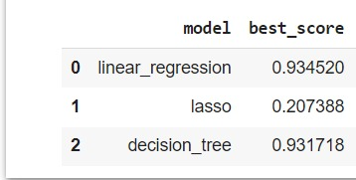
Comparison of Implementations

Slide 14
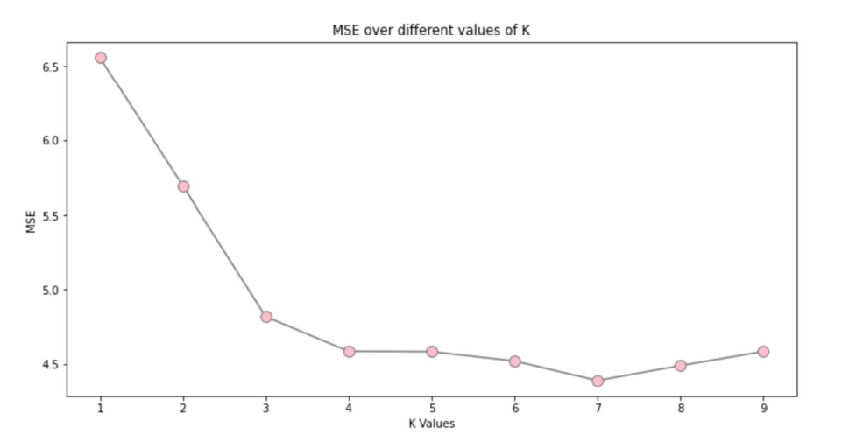

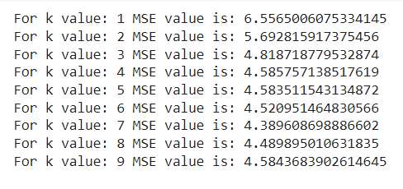

k-NN (K Nearest Neighbors)
The k-nearest neighbor algorithm, also known as KNN or k-NN, is a non-parametric, supervised learning classifier, which uses proximity to make classifications or predictions about the grouping of an individual data point. It can be used for either regression or classification problems.

Slide 15
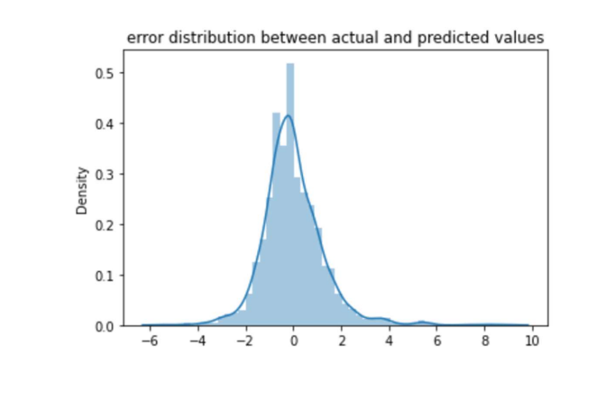
XG Boost Algorithm
XGBoost is an efficient implementation of gradient boosting that can be used for regression predictive modeling. XGBoost stands for “Extreme Gradient Boosting”. XGBoost is an optimized distributed gradient boosting library designed to be highly efficient, flexible, and portable. It provides a parallel tree boosting to solve many data science problems in a fast and accurate way.
After implementing the model, the following results were obtained:
MSE: 1.6229319104754887
RMSE: 1.273943448696012
r2 score: 0.9790100615537548

Slide 16
Result
From the interpretation of the applied models, we can conclude that XG Boost model would be best for our task as we obtained the best r2 score of 0.9790100615537548 and MSE score of 1.6229319104754887.
XGBoost is a powerful approach for building supervised regression models. It tells about the difference between actual values and predicted values, i.e how far the model results are from the real values.

